Slide 1
MasTagger What’s The Subject Person of This Photograph?
Demo ID 10 資工四
陳亮瑋 江東峻 林鈺惟

Slide 2
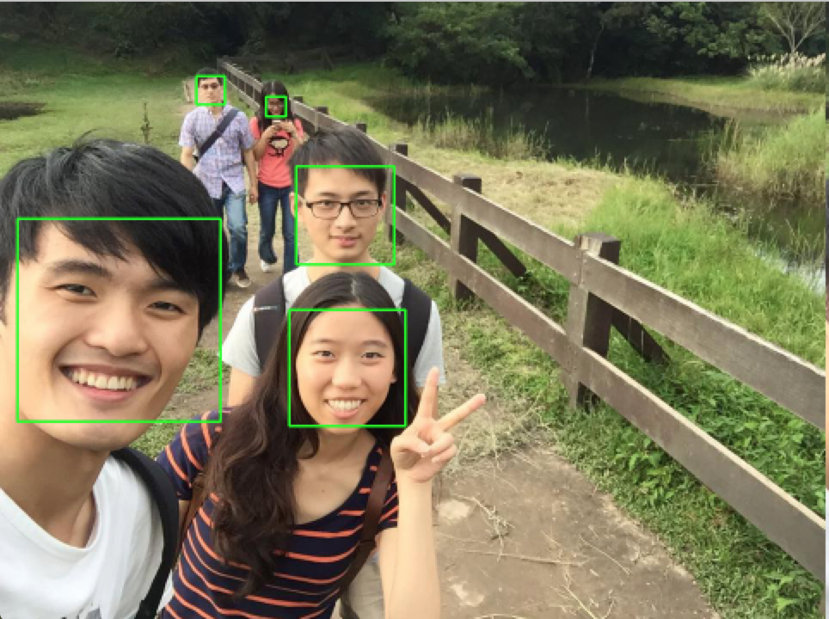
Motivation

Slide 3
Framework
Images with Face Detection
T/F/N
Semantic Tagging
Feature Extraction
Training Data
Machine Learning
Model
Testing Data
SVM
Application Use
Evaluation
5-fold Cross-Validation

Slide 4
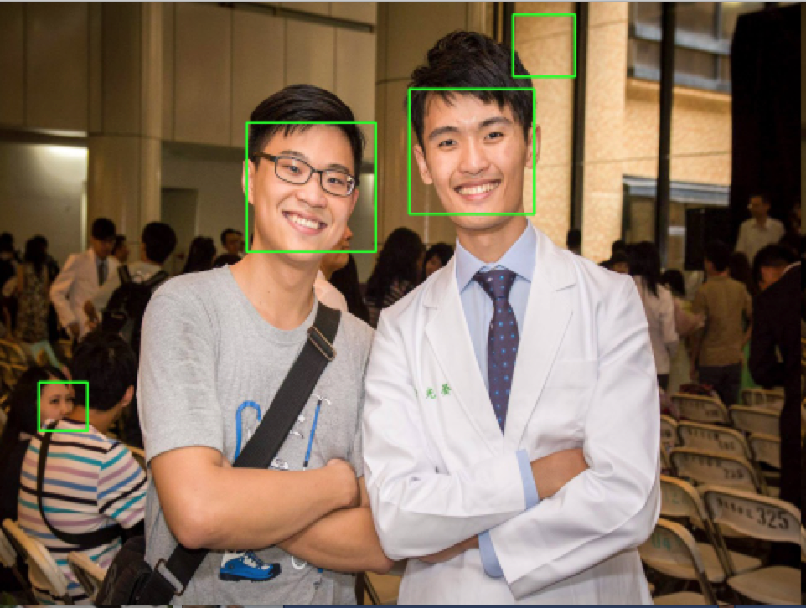
OpenCV Face Detection
Use Haar-cascade Detection in OpenCV
A widely used model: haarcascade_frontalface_alt2.xml
But there are some errors and the model cannot tell the subjects between non-subjects

Slide 5
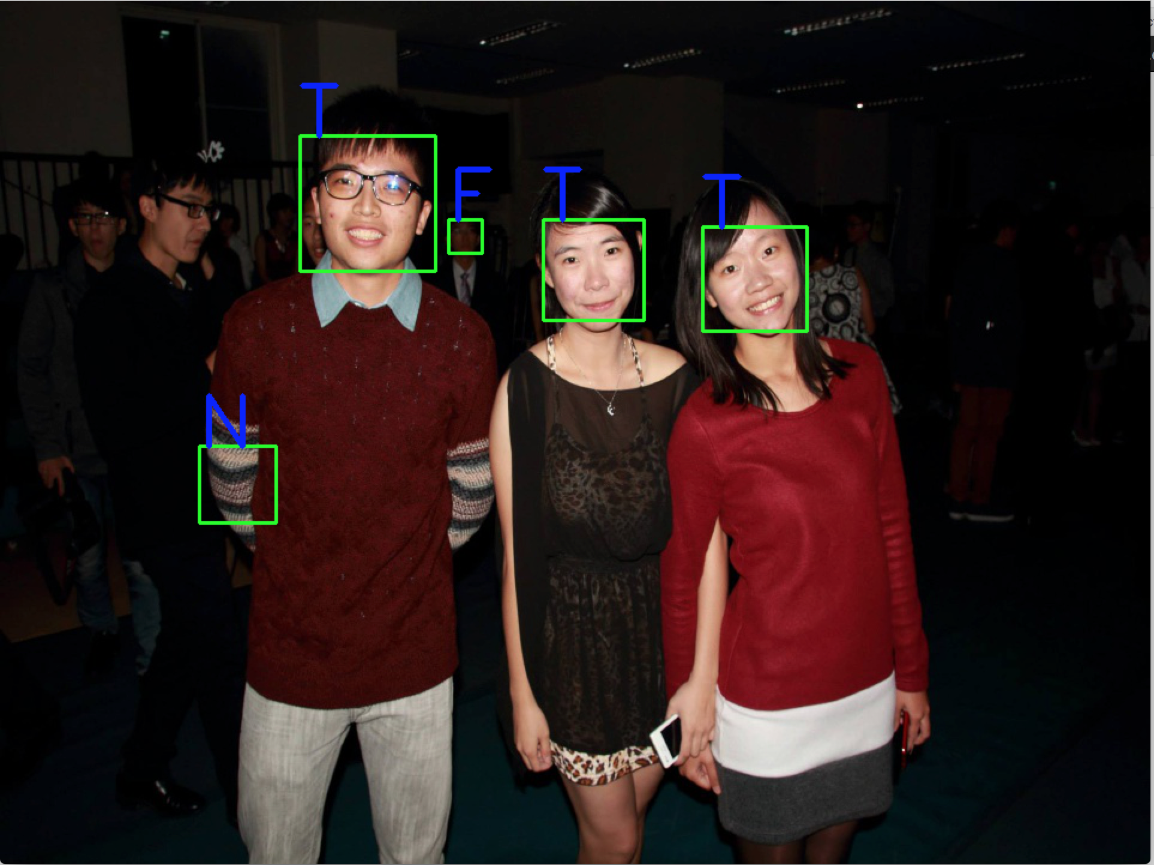
Semantic Tagging
Dataset : Crawl 2000 photos from Facebook
We use the 290 photos with not only Ts for training
Tag with 3 labels (within group consensus)
T : True Subject People
F : Non-Subject People
N : Non-Human Objects

Slide 6
Feature Extraction
Global Features : The feature of the whole image
Color histograms
The mean and variance of (x, y) and (width, height) of all faces in this image
Density (average distance of faces)
Local Features : The feature of a face
(x, y) and (width, height) of this face
Number of faces with the circle (r = 0.4 width)
Centrality
Histograms

Slide 7
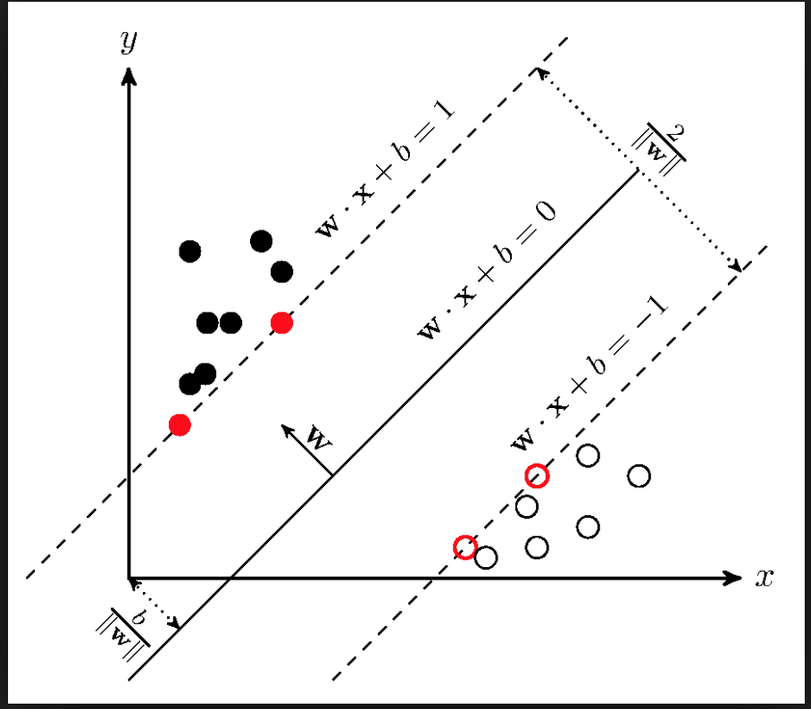
Machine Learning Model
Support Vector Machine (SVM) for classification problem (One versus One)
Radial basis function (RBF) kernel
Gird Search, C = 10
Each sample is re-weighted by
1/#(faces in this image)

Slide 8
Evaluation 5 fold cross-validation
Precision / Recall, weighted by 1/#(faces in this image)

Slide 9
Evaluation – F1 Score Convergence
1 N = whole dataset

Slide 10
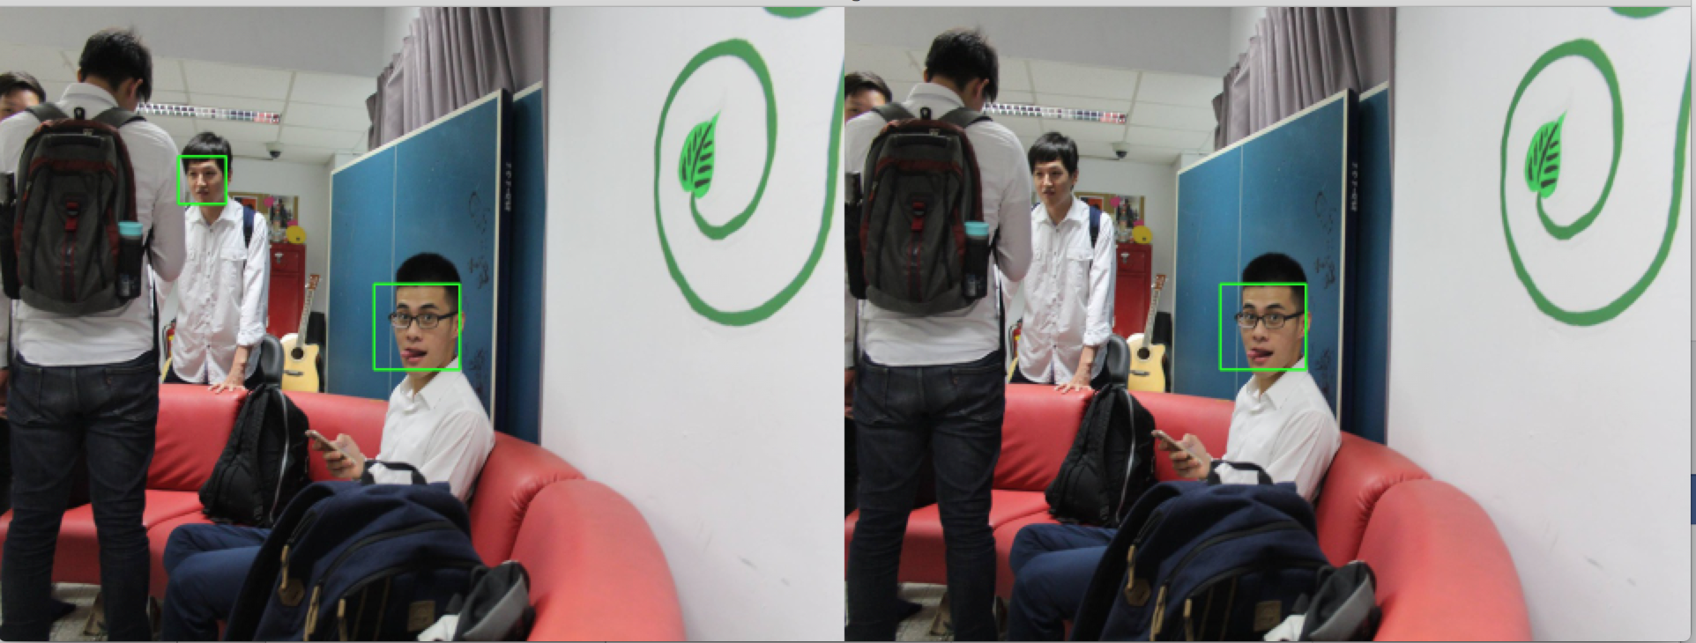
Demo (Static)

Slide 11
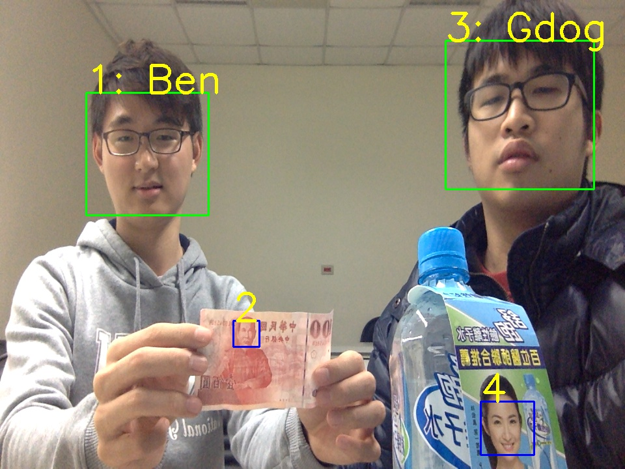
Real Time Camera !!!

Slide 12
Questions?

